Slide 1
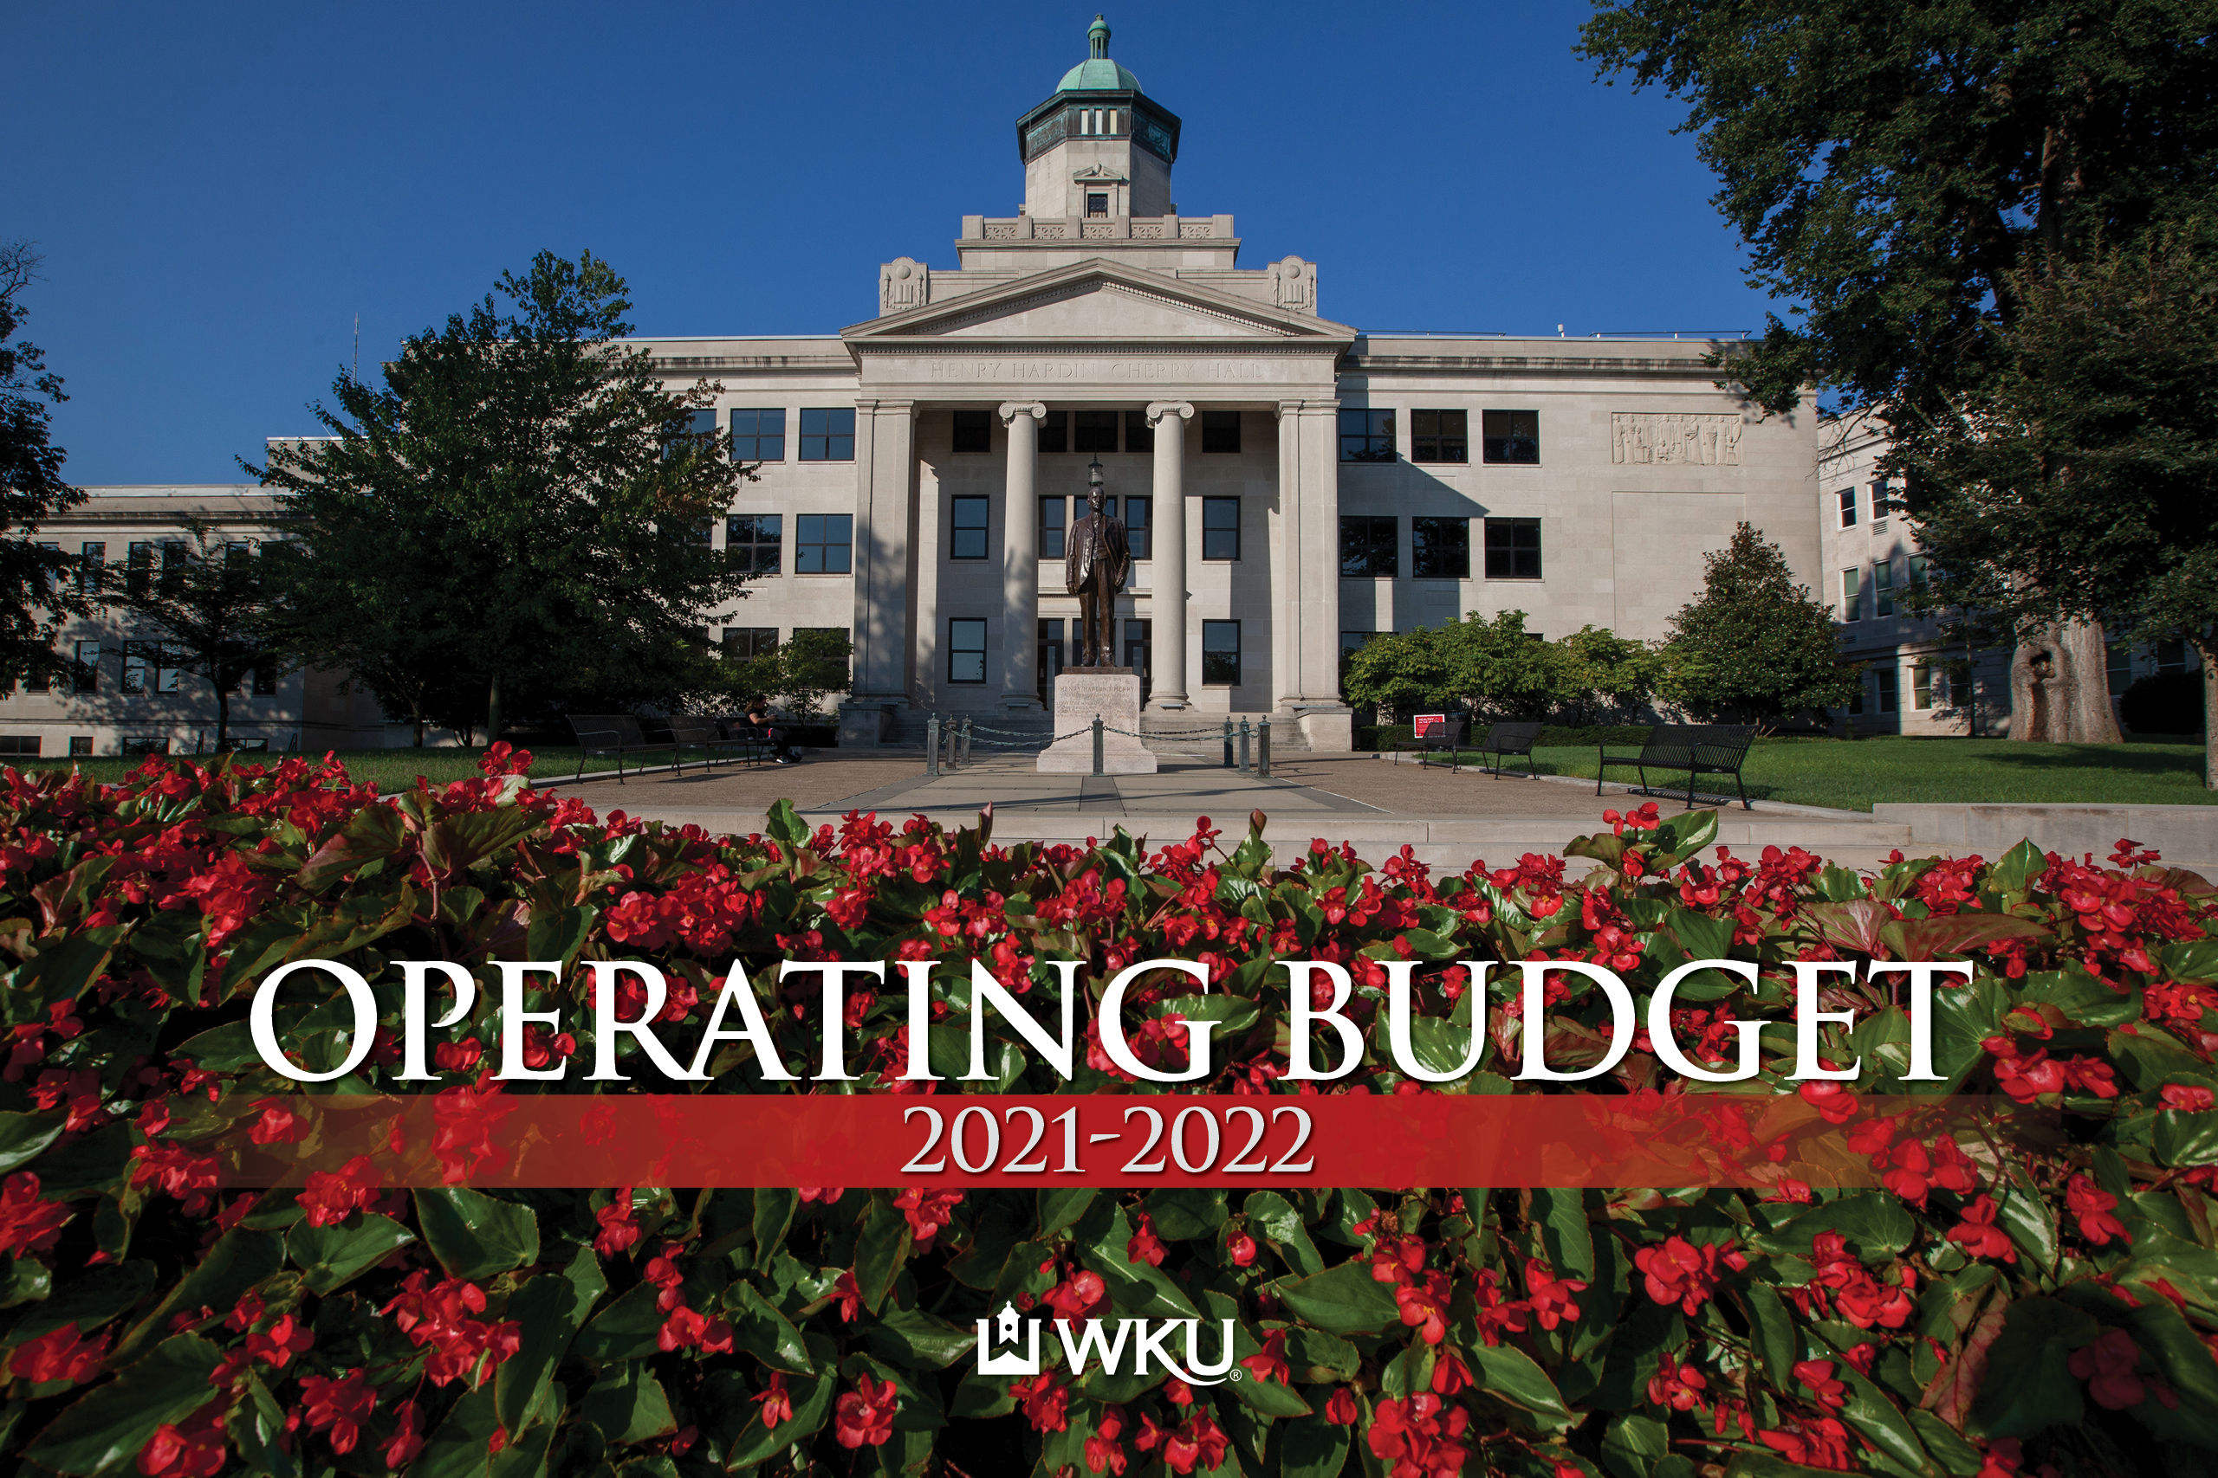
Board of Regents
FY22 Budget Presentation

Slide 2

Agenda
Outline of the FY22 Budget Development Process
High Level Budget Summary
Revenue Budget Highlights
Expenditure Budget Highlights
Budget Balancing Strategies
Capital Budget Highlights
Next Steps going forward

Slide 3
Budget Development Process

Slide 4
Budget Process at WKU
Campus Wide Representation, Involvement and Collaboration
Full Transparency

Slide 5
A Collaborative Budget Development Process
Support
Unit
Leadership
Primary
Unit
Leadership
Capital Allocation Committee
Operating Allocation Committee
Budget Executive Committee
Board of Regents
Campus Leadership
Student Government Association
Staff
Senate
Faculty
Senate

Slide 6
Timeline for Budget Development
Time Frame | Activity
2020 November – December | Governance Committee Meetings and Budget Hearings Begin
2021 January – February | Primary Unit Budget Request Submissions & Discussions
February – March | Operating Allocation Committee review fixed cost budget requests
March – April | OAC provide fixed cost recommendations to BEC Budget Recommendations sent to Campus Leadership
Early May | Campus Leadership communicate BEC Budget Recommendations with the Board of Regents and campus governance groups
May – Early June | Active monitoring of enrollment, revenue, & expenditure forecasts
June | Finalized Budget Presentation to Board of Regents

Slide 7
Budget Governance Committees
Operating Allocation Committee
Co-Chairs: Belinda Higginbotham, Bursar; Kristi Smith, Int. Chief Financial Officer
Brian Campbell – Staff Senate Representative
Guy Jordan** – Chair, Faculty Senate Budget Committee
Ranjit T. Koodali – Associate Provost for Research and Graduate Education
Eric Reed** – Chair, History
Chris Shook – Dean, Gordon Ford College of Business
Todd Stewart – Director of Athletics
John Sunnygard – Associate Provost for Global & International Affairs
Amanda Trabue – VP for Philanthropy & Alumni Engagement
Robert Unseld – Staff Representative
Bruce Schulte* – Associate VP for Strategy, Perf. & Accountability
Jeppie Sumpter* – Int. Assist. VP, Information Technology
*Denotes non-voting member
**Denotes Ex Officio appointment (with voting privileges)

Slide 8
Budget Governance Committees
Capital Allocation Committee
Chairs: Bryan Russell, Chief Facilities Officer
Greg Arbuckle*** – Dean, Ogden College of Science & Engineering
Craig Biggs* – Associate Athletic Director
Ken Branch* – Director of Facilities Management
Mark Ciampa** – Faculty Representative
Susann E. deVries – Dean, University Libraries
Amy Fugate* – Director of Accounting & Financial Reporting
Larry Snyder – Dean, Potter College of Arts & Letters
Jessica Steenbergen* – Scheduling Applications Coordinator
Doug Tate – Staff Representative
Jennifer Tougas* – Int. Assistant VP for Business Services
Travis Wilson** – Chair, Applied Human Sciences
*Denotes non-voting member
**Denotes Ex Officio appointment (with voting privileges)
***Denotes 1 year membership

Slide 9
Budget Governance Committees
Budget Executive Committee
Co-Chairs: Cheryl Stevens, Provost; Susan Howarth, Executive Vice President
Kirk Atkinson – Faculty Senate Representative
Tania Basta – Dean, College of Health & Human Services
Brian Dinning – Staff Representative
Holli Drummond – Faculty Representative
Mike Loftis** – Chair, Staff Senate
Ethan Logan – VP, Enrollment & Student Experience
Corinne Murphy – Dean, College of Education & Behavioral Sciences
Abbey Norvell – Student Government Association Representative
Julie Shadoan** – Chair, Faculty Senate
Ladonna Hunton* – Associate VP for Academic Budget & Administration
*Denotes non-voting member
**Denotes Ex Officio appointment (with voting privileges)

Slide 10
FY22 Budget Summary

Slide 11
Total Proposed FY22 Budget
 | FY20 Budget | FY22 Budget | Dollar Change | Percent Change
Total E&G | 364,353,000 | 359,383,525 | (4,969,475) | (1%)
Unrestricted E&G | 302,906,000 | 301,715,525 | (1,190,475) | (0%)
Restricted E&G | 61,447,000 | 57,668,000 | (3,779,000) | (6%)
Total Auxiliary Enterprises | 23,409,000 | 16,293,650 | (7,115,155) | (43%)
Total Budget | $387,762,000 | $375,677,370 | ($12,084,630) | (3%)

Slide 12
Total Proposed FY22 Budget
Total: $375,677,370
Percent Change - (3%)

Slide 13
Revenue Budget Highlights

Slide 14
Revenue Budget Highlights - Sources
 | Amount | Percent of Budget
Tuition & Fees | 180,357,700 | 48%
State Appropriations | 73,354,100 | 21%
Restricted Funds |  | 15%
Grants & Contracts | 15,400,000
Student Financial Aid | 42,268,000
Self-generated Funds | 29,392,425 | 8%
Carry Forward Funds | 13,620,000 | 4%
Auxiliary Enterprises | 16,293,845 | 4%
Total | $375,677,370 | 100%
69% of revenue

Slide 15
Revenue Budget Highlights - Sources

Slide 16
Revenue Budget Highlights – Tuition & Fees
The tuition and fee revenue is anticipated to increase slightly as a result of several new scholarship programs:
  Hilltopper Guarantee,
  WKU Family Scholarship
  Border State Scholarship.
The first-time freshmen enrollment indicators, such as paid housing deposits and application fees, remain strong despite limited access to high schools during the past recruitment year.
Fee revenue is also anticipated to remain unchanged for FY22.

Slide 17
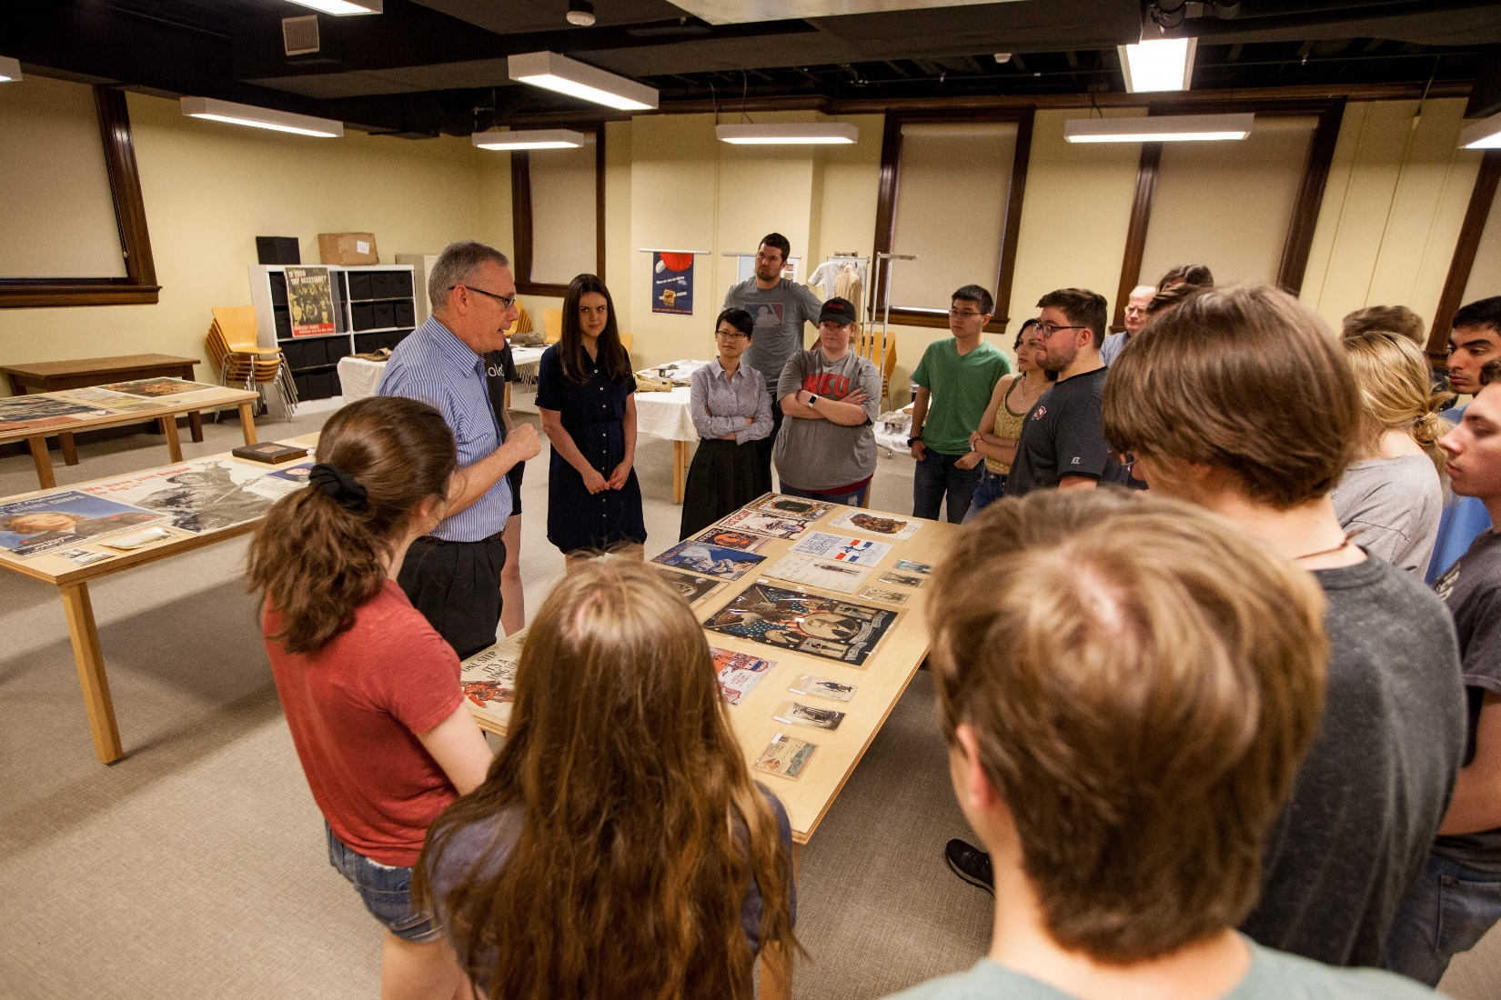
Revenue Budget Highlights – Tuition & Fees
The Council for Post-Secondary Education (CPE) has statutory authority for setting tuition rates
CPE enacted a fee-setting schedule enabling universities to increase tuition no more than 3.0% over the next two years, with a one year maximum of 2.0%.
FY22 tuition rates:
  2.0% increase with the exception of graduate tuition that will remain unchanged.
Distance Learning fee has been permanently eliminated.

Slide 18
Revenue Budget Highlights – State Appropriation
 | 2021-22
General Operating | 67,619,000
KY Academy for Math & Science | 4,985,100
Kentucky Mesonet | 750,000
KERS Supplemental Funding | 3,592,500
Performance Funding | 1,398,800
Total | $78,345,400
FY22 state appropriation is approximately $5M more than the prior year:
  $757,900 increase to the base state appropriation
  $1.4M increase in performance funding from the KY General Assembly passing a $17M increase in Performance funding to be allocated between all state institutions.
  $3.6M from the KY General Assembly providing supplemental funding to cover the increase in the KERS rate. This will be reduced each year so the university can transition to fully fund the employees in this retirement program.

Slide 19
Revenue Budget Highlights – State Appropriation
WKU Net General Fund Appropriations* per FTE Student
*In constant FY20 dollars. Excludes Gatton Academy of Mathematics and Science, Kentucky Mesonet and state supported debt service.

Slide 20
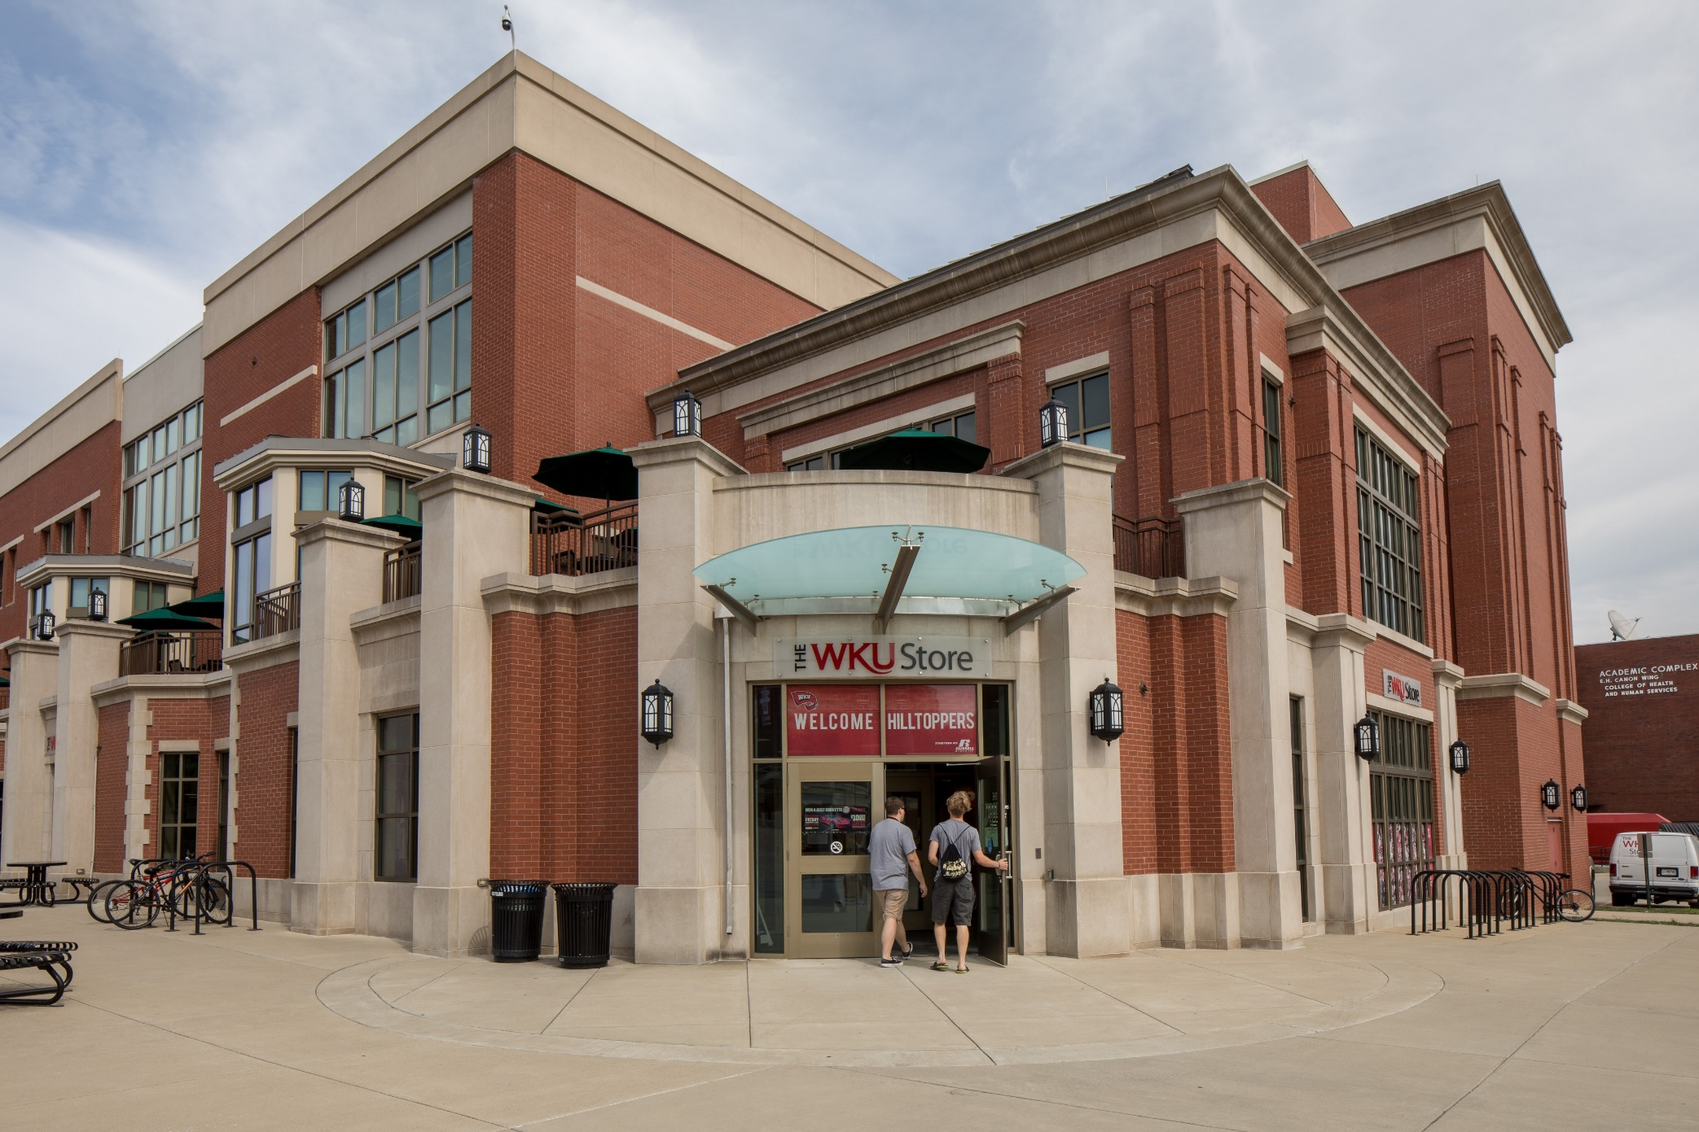
Revenue Budget Highlights – Auxiliaries
Auxiliaries are self-supporting programs that use fees or third-party contracts to generate funds to sustain the program. This includes housing, dining, and contracted university services such as Aramark. All auxiliary funds combine to $16,293,845.
As a reminder, the WKU Store transitioned to Barnes & Noble College management in FY21. When comparing FY22 to FY20, which was prior to the transition, revenue and expenditure budgets have decreased by approximately $6.1 million to reflect this change.

Slide 21
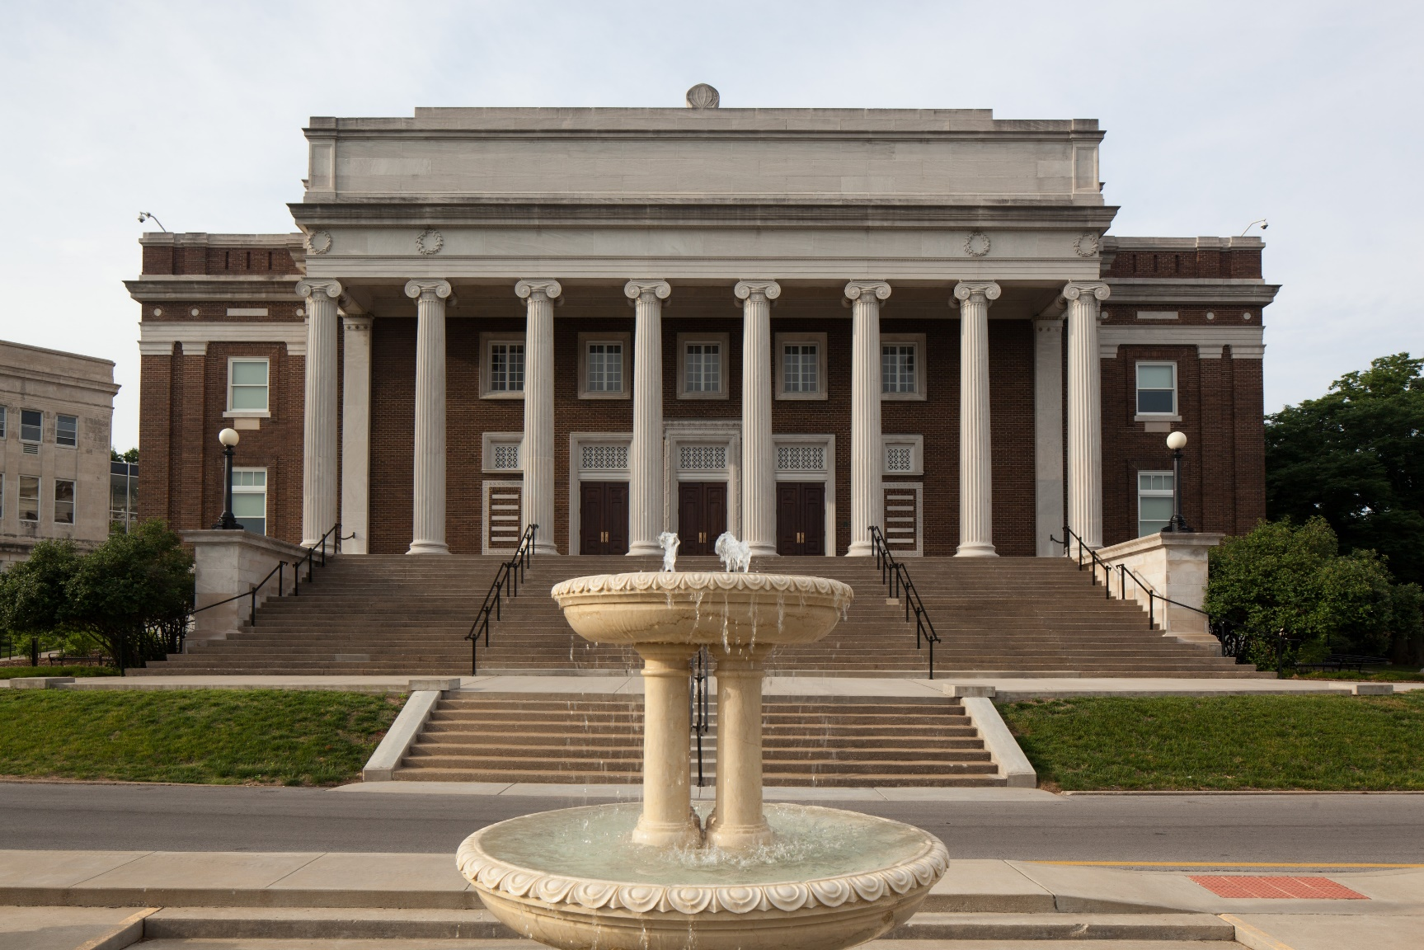
Revenue Budget Highlights – Sales & Service Revenues
Self-generated revenue, or Sales & Services Revenues, are anticipated to increase back to FY20 levels after a sharp decline due to COVID-19 and the cancellation of events, decreased rentals, and a reduction in athletic revenue.
Note – any revenue dependent units will have expenditures to match the amount of revenue collected.

Slide 22
Expenditure Budget Highlights

Slide 23
Expenditure Budget Highlights
Total Budgeted Expenditures by Major Classification
Major Classification | Unrestricted | Restricted | Auxiliary | Total | Percent
Personnel | $170,356,300 | $118,400 | $6,619,700 | $177,094,40 | 47.1%
Operating Expenses | $49,582,100 | $15,000,000 | $6,630,600 | $71,212,700 | 19%
Utilities | $7,145,700 | - | - | $7,145,700 | 1.9%
Capital Outlay | $2,179,700 | - | $466,500 | $2,646,200 | 0.7%
Student Financial Assist. | $57,793,300 | $42,549,600 | - | $100,342,900 | 26.7%
Debt Service | $14,658,400 | - | $2,577,000 | $17,235,400 | 4.6%
Total | $301,715,500 | $57,668,000 | $16,293,800 | $375,677,300 | 100%

Slide 24
Expenditure Budget Highlights

Slide 25
Expenditure Budget Highlights
FY22 expenditures are down in all major categories, with the exception of Student Financial Assistance.
  Student Financial Assistance increases by approximately $5 million due to a new scholarship model
Academic Affairs, WKU’s largest division, totals $156 million, or 47%, of the total unrestricted E&G budget.
University wide expenditures include bond payments, institutional scholarships, and additional funding for potential increases to the Kentucky Retirement System contribution rates.

Slide 26
Expenditure Budget Highlights - Personnel
2% Faculty and Staff salary increase pool
  Salary Adjustments become effective January 1, 2022
  Method(s) to Distribute Salary Increase to be determined
    Compensation Study
    Compression
    Across-the-board

Slide 27
Expenditure Budget Highlights – Fixed Cost Increases
As part of the RAMP budget process, the Operating Allocation committee provided recommendations to the Budget Executive Committee for the prioritization of FY22 fixed cost allocations. The approved allocations are as follows:
Fixed Cost Increases | Amount
IT Software Funding/Contract Increases | 415,560
Ogden Graduate Assistantships | 60,000
Marching Band Funding | 160,000
Strategic Investment Fund Increase | 185,000
Total | $820,560

Slide 28
Expenditure Budget Highlights

Slide 29
Expenditure Budget Highlights
Division | Personnel | Operating | Student Aid | Capital Outlay | Debt Service | Total
Academic Affairs | 113,824,752 | 32,593,407 | 9,331,156 | 561,005 | - | 156,310,320
Enrollment & Student Experience | 19,241,618 | 7,894,894 | 42,016,328 | 580,804 | 2,415,000 | 72,148,644
University Wide | 2,230,632 | 9,983,312 | 40,608,968 | - | 14,282,868 | 67,105,780
Strategy, Operations & Finance | 25,189,827 | 19,961,890 | - | 1,390,735 | 537,529 | 47,079,981
Athletics | 8,973,752 | 6,473,083 | 7,764,869 | 26,000 | - | 23,237,704
Philanthropy & Alumni Engagement | 3,459,751 | 586,964 | - | 20,350 | - | 4,067,065
Communications & Marketing | 3,151,348 | 773,194 | - | 67,224 | - | 3,991,766
Presidential | 1,644,334 | 91,776 | - | - | - | 1,736,110
Total | $177,716,014 | $78,358,520 | $99,721,321 | $2,646,118 | $17,235,397 | $375,677,370

Slide 30
Balanced Budget Approach

Slide 31
Balanced Budget Approach
The FY22 budget includes budget reduction targets of $5.8M.
  $3.1M – Academic Affairs primary & support units
  $2.7M – Administrative support units
The new budget reduction targets are to be managed at the Divisional level by the respective Deans and Vice Presidents with no Central reduction targets included for FY22.

Slide 32
Balanced Budget Approach

Slide 33
Capital Budget

Slide 34
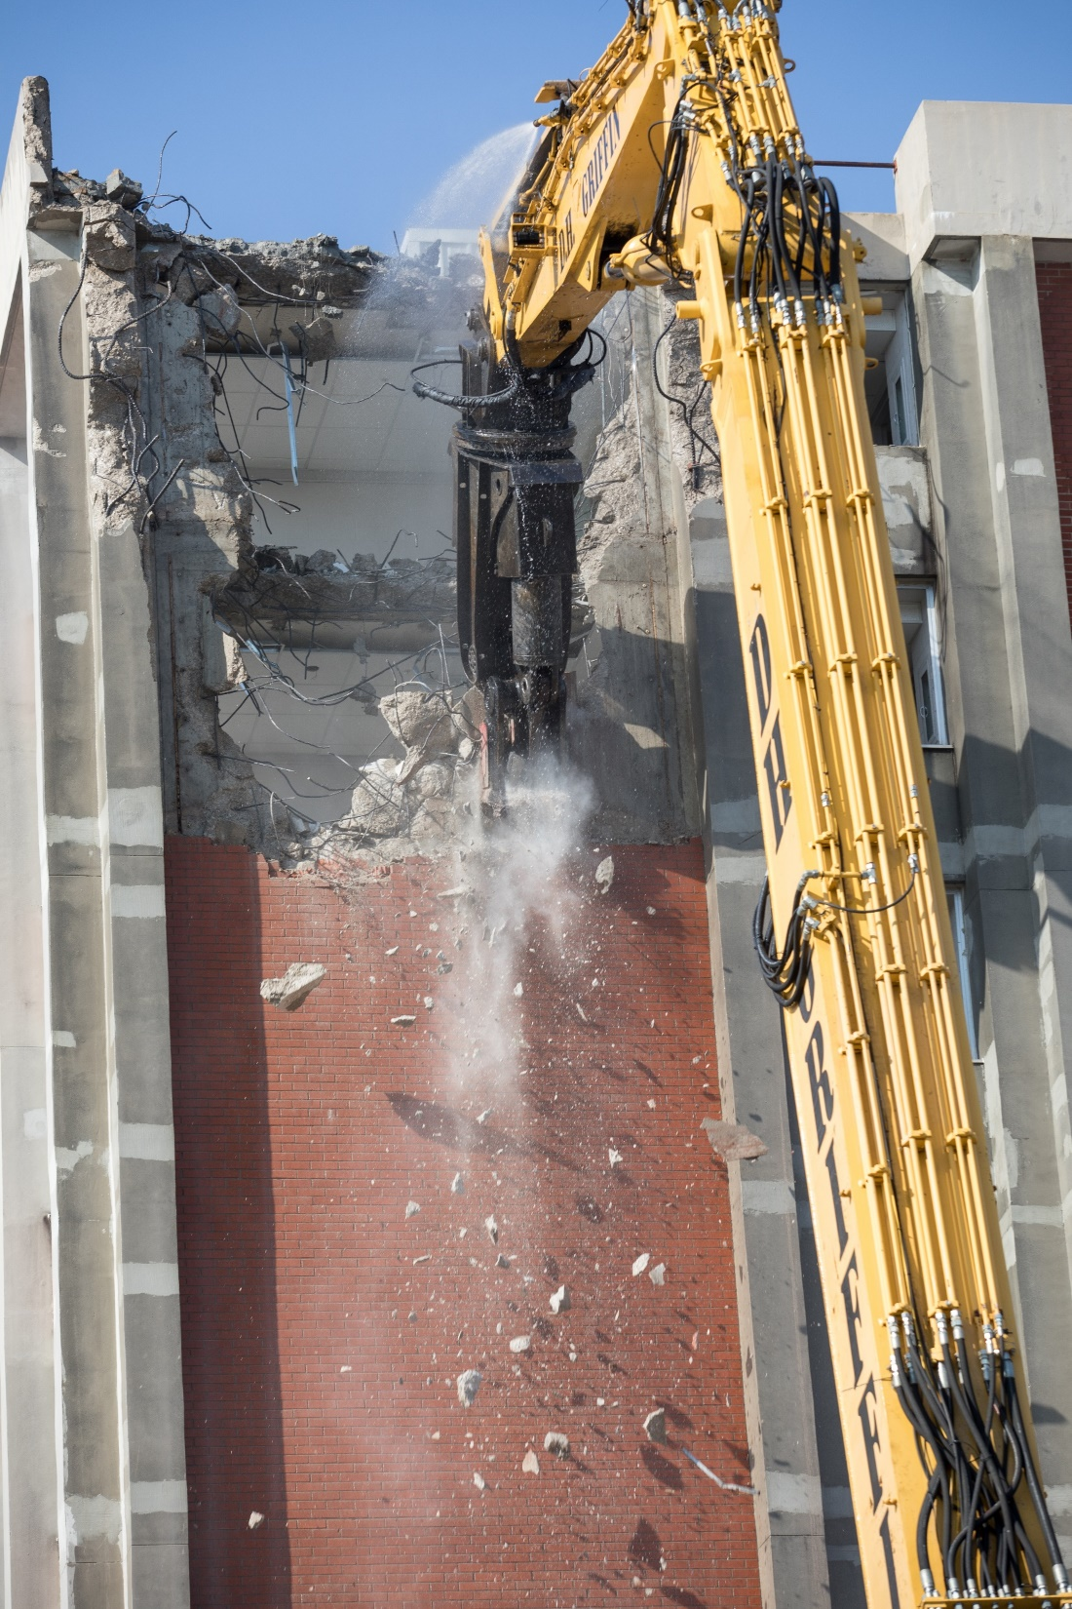
Capital Budget
Total Capital Budget: $65,500,000
  2020-22 Authorized Projects (HB 352)
    Demolish Tate Page Hall/Improve Site - $6,000,000 est.
      In progress
    Demolish Garrett Conference Center - $7,000,000 est.
      In progress
  2018-20 Authorized Projects (HB 200)
    Renovate Helm/Cravens Library (WKU Commons) - $38,500,000 est.
      Renovation/Construction in progress
    Capital Renewal Pool - $10,000,000
      As needed
    Upgrade Underground Infrastructure - $1,000,000
      Planning Stages underway

Slide 35
Next Steps Going Forward

Slide 36
Looking Forward to FY 23 and Beyond
Implementation of RAMP
  Revenue targets will be established for primary academic units during mid-to-late summer annually in partnership between Enrollment & Student Experience, Academic Affairs and Strategy, Operations and Finance.
  The budget development will become a year-round process.
Long-term financial plan
  Axiom will allow for long-term forecasting and development of 3, 5, and 10-year financial plans.
  Making progress.
The plan will be to complete the FY23 Operating Budget in late April 2022, with Board of Regents budget workshop in May 2022.

Slide 37
Budget Monitoring and Contingency Planning
Monthly Budget Monitoring:
  Will continue active budget monitoring
    Payroll Spend
    Procurement Spend
    Budget vs Actual by unit
    Quarterly Cash and Financial Position Reporting
  Reports presented to President monthly – schedule required meetings with Deans and Vice Presidents

Slide 38
Questions?

